Slide 1

Team-DMMTI
Mathematical games
By:Mertin Dikmeshefket ,Dimitar Dimitrov ,Martin Mechkov, Teodor Todorov ,Ivaylo Markov

Slide 2









Used programs

Slide 3

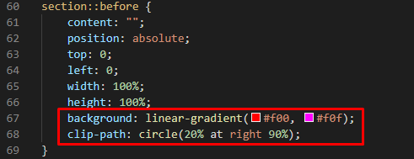
Our Home page

Slide 4
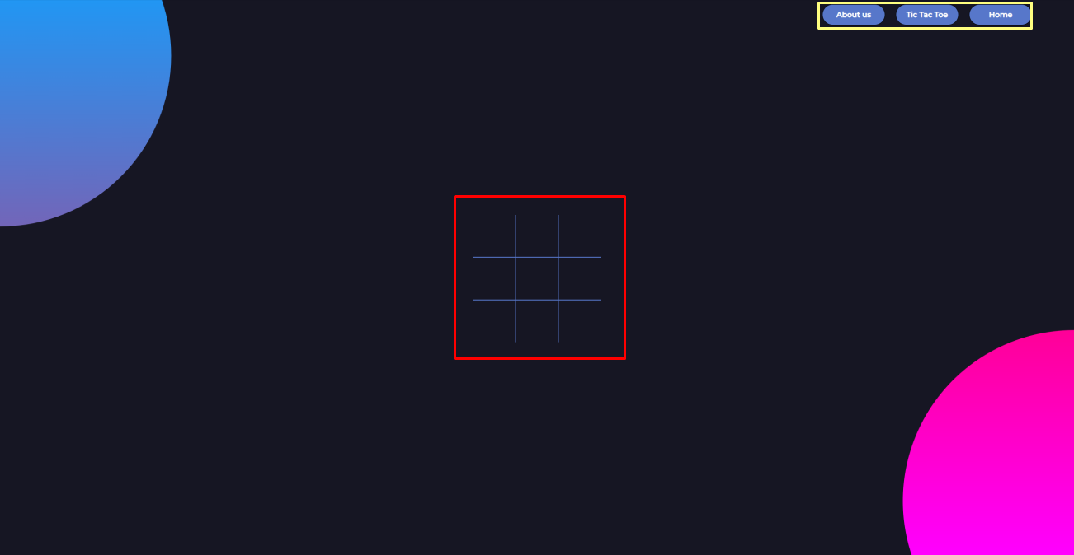
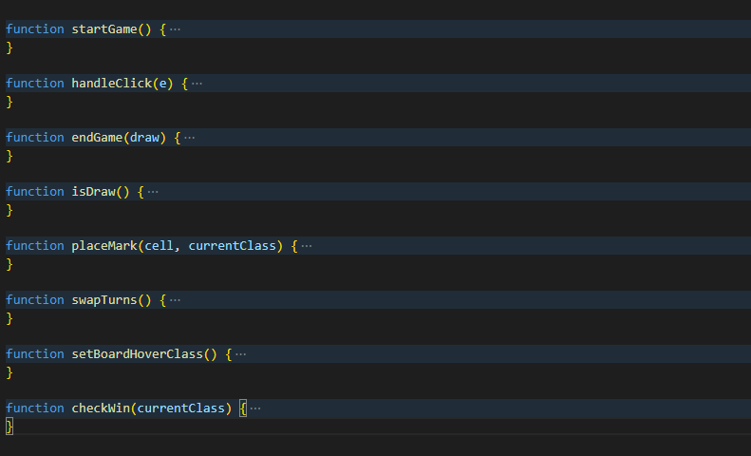
Navigation Bar
Tic Tac Toe game
Tic Tac Toe game
JavaScript code

Slide 5


Rules

Slide 6

About us page
Information card with hove effect

Slide 7

Contact us
DSDimitrov19@codingburgas.bg
MMMechkov19@codingburgas.bg
MSDikmrshefket19@codingburgas.bg
TYTodorov19@codingburgas.bg
IPMarkov19@codingburgas.bg

